Slide 1
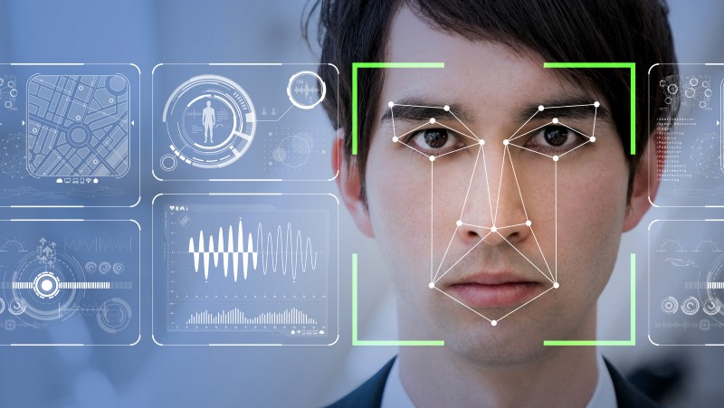
Facial Recognition Attendance System
TEAM MEMBERS :
Varun kumar potta (RA2111026010255)
Mohithjayavaram (RA2111026010241)
Bhavana Moparthi (RA2111026010212)

Slide 2
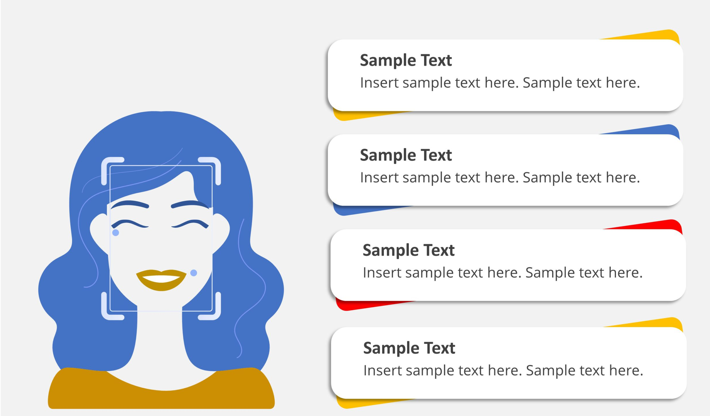

Content Title
Abstract
Introduction
Objective
Literature Survey

Slide 3

Abstract
The facial recognition attendance system is designed to revolutionize traditional attendance methods by leveraging advanced technologies.
This system aims to enhance efficiency, accuracy, and accessibility in tracking attendance for students and staff in educational institutions.
By utilizing face databases, recognition algorithms, and real-time processing, the system can automatically identify individuals, record attendance data.
The implementation involves creating a user-friendly interface, enabling face storage for new individuals, and providing clear indications of successful recognition.

Slide 4

Introduction
Face recognition attendance systems use advanced computer technologies to identify individuals based on their facial features. These systems are replacing traditional attendance marking methods such as calling student names and checking identification cards. They can be used in a variety of fields
Face recognition is one of the most important applications of image processing in the technical world. The process of identifying students using a face biostatistics system based on high-definition monitoring and other computer technologies is called a face recognition attendance system
Facial recognition is a category of biometric software that maps an individual's facial features mathematically and stores the data as a faceprint. The software uses deep learning algorithms to compare a live capture or digital image to the stored faceprint in order to verify an individual's identity.

Slide 5
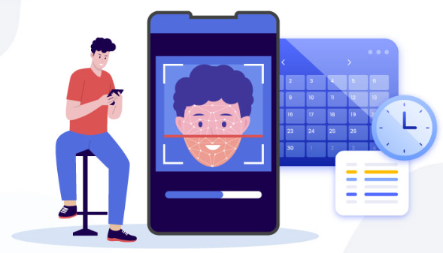
Objective
Primary objective :
Develop and implement a facial recognition attendance system to streamline the attendance tracking process, enhance accuracy, and improve overall efficiency within educational institutions or corporate environments.
Key roles :
Security: Discuss how facial recognition enhances security measures by ensuring that only authorized personnel can access sensitive areas or record their attendance.
Convenience: Point out the convenience of using facial recognition technology. Employees no longer need to carry physical badges or remember PINs or passwords,
User-Friendly Interface: Describe the user-friendly interface of the system, which makes it easy for both employees and administrators to navigate. Intuitive design and clear instructions contribute to a positive user experience.
Privacy Measures: Address any concerns about privacy and data security by explaining the measures taken to safeguard biometric information

Slide 6
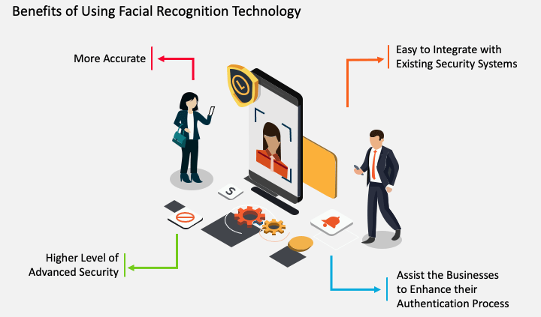
Benefits

Slide 7

Literature Survey
A literature survey on facial recognition attendance systems would typically involve reviewing relevant academic papers, research articles, conference proceedings, and other scholarly sources that discuss various aspects of facial recognition technology in the context of attendance management. Below, I'll outline a structured approach to conducting such a literature survey
User Experience and Acceptance:
Review research on user acceptance and satisfaction with facial recognition attendance systems. Understand user experiences, perceptions, and concerns regarding usability, reliability, and convenience.
Integration with Existing Systems:
Explore how facial recognition attendance systems integrate with existing infrastructure, such as time and attendance management software, access control systems, and HR databases.

Slide 8
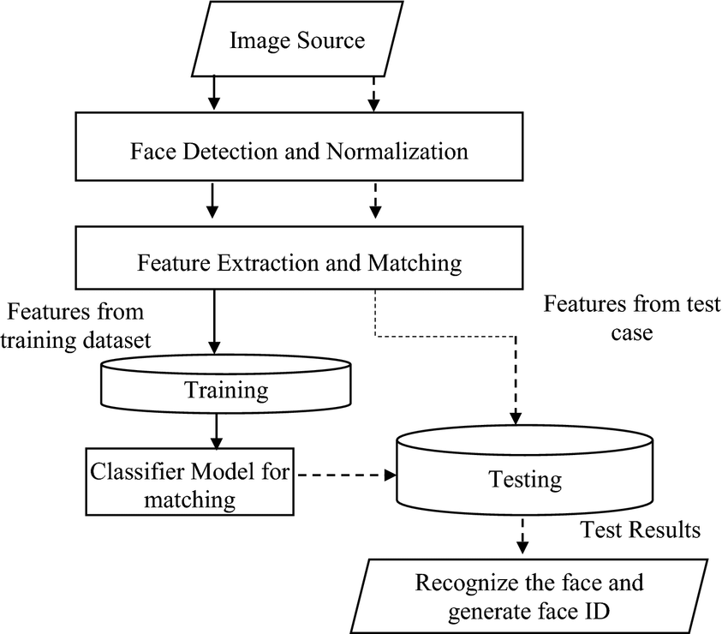
System diagram

Slide 9
References
https://www.lystloc.com/blog/what-is-facial-recognition-attendance-system-and-its-top-benefits-in-the-workplace/
https://www.jibble.io/face-recognition-attendance-system
https://truein.com/face-recognition-attendance-system/
https://www.perplexity.ai/search/Facial-recognition-project-5g9tQRFUQwy_Xeg.TnuzSg/

